Slide 1
Testing RESTful Web Services
Hilary Weaver-Robb

Slide 2





































TITANIUM SPONSORS
Platinum Sponsors
Gold Sponsors

Slide 3


Who dis
Hilary Weaver-Robb
SQA Architect, Quicken Loans - Detroit
@g33klady
G33klady.com
Github.com/g33klady
@g33klady | g33klady.com | github.com/g33klady

Slide 4

objective
What a Web service is
What makes a Web service RESTful
Why we should test Web services
How to test RESTful Web services
Manually
With Automation
Note: when you see this icon, it means you should be hands-on

Slide 5
What is a Web Service?
A Web service is a method of communication between two electronic devices over a network.
It is a software function provided at a network address over the Web with the service always on as in the concept of utility computing.
The W3C defines a Web service generally as: a software system designed to support interoperable machine-to-machine interaction over a network.
^{- Wikipedia}

Slide 6
What Is A Web Service?
A website provides information consumable by humans
A web service provides information consumable by software
- A genius on StackOverflow
All Web services are APIs, but not all APIs are Web services

Slide 7
What Makes A Web Service RESTful?

Slide 8
What Is REST?
A way for systems to talk to one another (not always Web services)
REST stands for REpresentational State Transfer
Constraints:
Uniform Interface
Stateless
Cacheable
Client-Server
Layered System
Notes:
We’ll keep it high level, this isn’t a workshop on building RESTful APIs
We’ll go through a few of the most important aspects for the concepts we’ll cover today

Slide 9
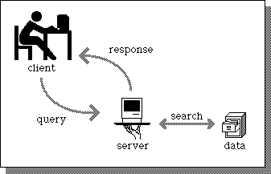

What Makes a web service restful?
Client-Server architecture using HTTP protocol
Client sends Request to Server
Server sends Response back
Notes:
The main factor of a RESTful web service is the client-server architecture using HTTP protocol.
(explain)

Slide 10
What makes a web service restful?
URL tells you what you’re working with and doing
Messages can be lightweight (even just the URL!)
CRUD operations use HTTP methods
Create/Update data (POST, PUT)
Read data (GET)
Delete data (DELETE)
WAY easier to test than non-RESTful services

Slide 11
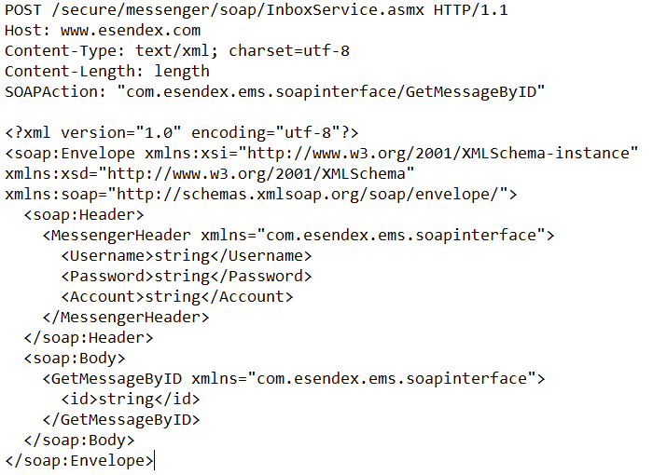
comparison
Notes:
REST = simple, SOAP = complicated

Slide 12
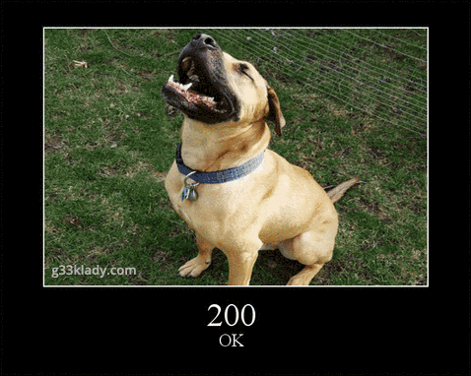
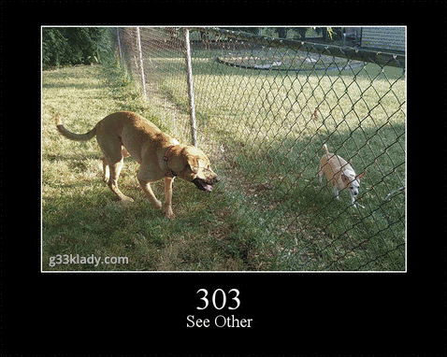
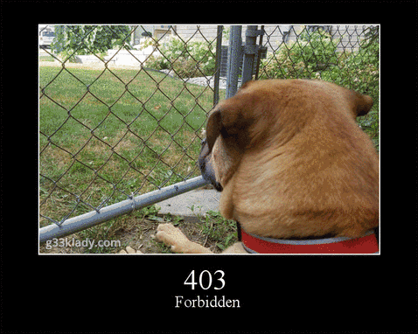
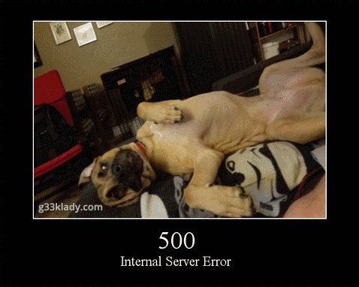
http response codes
200s – Request was successful!
300s – Redirection (Need more from the Client)
400s – You screwed up (Client issue)
500s – We screwed up (Server issue)

Slide 13
Why should we test web services?

Slide 14
Why test web services?
HTML &
CSS
JavaScript
API
Backend
Notes:
You have this web service, and no matter if it’s being consumed
by your own user interface (with HTML & CSS and JavaScript) or

Slide 15

Why test web services?
Someone else’s code
API Client
API
Backend
Notes:
It’s consumed by somebody else’s code, or a simple API client like Postman, this is still code that needs to be tested!
And what about the people that turn off JavaScript? Are you sanitizing people’s inputs just in the JavaScript or are you checking at the API level?
The last thing you want is for your webserver to seize because someone turned off JavaScript and created a new item with too many characters

Slide 16
Why test web services?
Usually complete before UI is even started
Not everyone wants to use the UI!
Validate the ductwork
UI can pull in multiple Web services
Because it’s code!
UI Tests
Integration Tests
Unit Tests
Notes:
* This is the Test Automation Pyramid. You should have a large amount of Unit tests, Integration tests (which is our web service tests), and then some smaller amount of UI tests.
However, this isn’t a 1 size fits all kind of deal. You may not need UI tests at all

Slide 17
Your Test Pyramid
What do you think your test pyramid looks like now?
What does your ideal test pyramid look like?
UI
Tests
Unit
Tests
Integration
Tests
Integration Tests
UI Tests
Unit Tests
Notes:
Exercise to draw their own pyramid – what is your ratio now vs what do you think it should be?
* Is it UI heavy
* Is it the right ratio now?
<< 5 minutes >>

Slide 18
How can we test RESTful web services?

Slide 19
What types of tests can we perform?
Smoke tests
CRUD tests
Boundary
Required Fields
Field Type
Error Conditions
Security
Performance
Contract

Slide 20
How can we test web services?
Manual Testing Tools
Postman
Fiddler
Advanced REST Client
ReadyAPI (SoapUI)
Swagger
Automation Tools
Postman
ReadyAPI
Most unit testing frameworks
Notes:
We’re going to be using Postman and Nunit with C# for the workshop

Slide 21

Load it up!

Slide 22
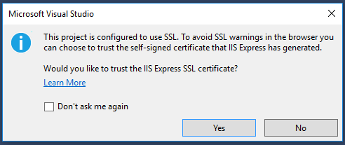
You Should have:
Visual Studio 2017 version 15.7.3 or later
Postman
Repo cloned locally:
https://github.com/g33klady/TodoApiSample
Run the solution!
Notes:
Everyone should be able to run the solution locally. Raise your hands if you have any issues
Potential for Self Signed Cert warning when running
To eliminate the security warning when browsing and debugging HTTPS on localhost, we added a dialog to allow Internet Explorer and Chrome to trust the self-signed IIS express SSL certificate.

Slide 23
What to test?

Slide 24
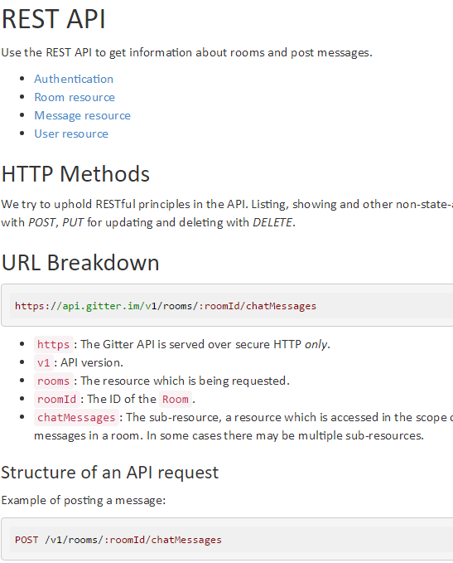
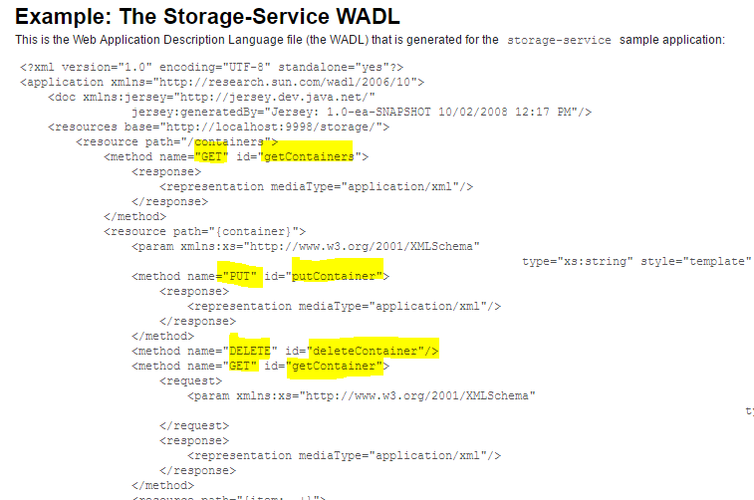
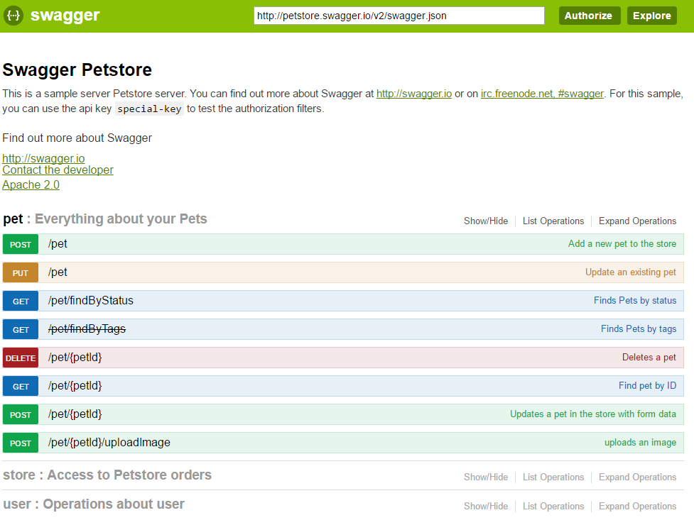
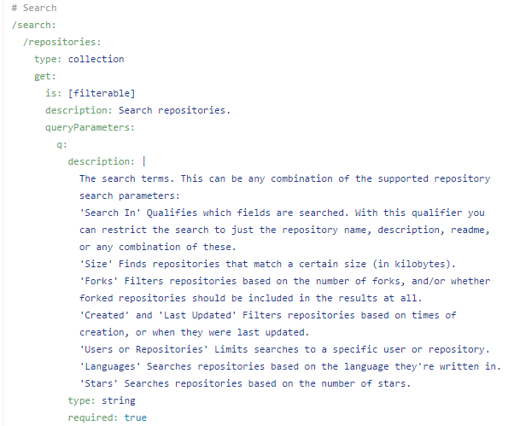
How can I figure out what to test?
Documentation
Swagger
WADL/WSDL
RAML (RESTful API Modeling Language)

Slide 25
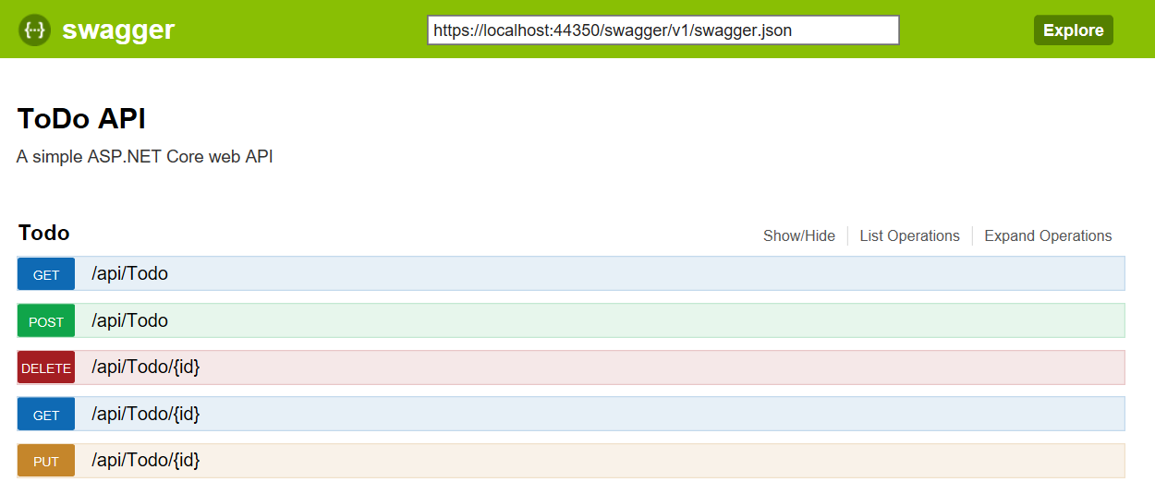
How can I figure out what to test?
https://localhost:[port]/swagger
Notes:
The Swagger specification uses JSON and JSON Schema to describe a RESTful web API
Click on Todo to expand
Click on the first GET to expand it
We can see all kinds of information about it, like the response model, and example response, the response content type.
And we can try our API from here

Slide 26
How can I figure out what to test?
Check out the code
Controllers
Models
Tests
Run web debugger and follow the calls
Notes:
We can also learn about what to test by looking at our code
If you take a look at the Controllers, we can glean all kinds of good info from there
We can also load up the UI, and run the dev tools in the browser, or something like Fiddler, and see what the requests look like. Let’s try that out
Debug your solution, and hit F12 to run the dev tools. Go to the Network tab
Now add a new item and click Save. Notice there is a POST call, then some GET calls. You can click on each one to see what the actual request looked like, the response, etc

Slide 27
Todo resource specs
List all to-do items
GET https://localhost:[port]/api/todo
Get a single to-do item
GET https://localhost:[port]/api/todo/:id
Add a new to-do item
POST https://localhost:[port]/api/todo
Update a to-do item
PUT https://localhost:[port]/api/todo/:id
Delete a to-do item
DELETE https://localhost:[port]/api/todo/:id

Slide 28
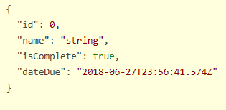
Todo item Model
Notes:
Our to-do items are pretty simple – this is the model that we’ll use, or the json schema, for all of our work.
Take a look at the TodoItem class under the Models folder, to see the definitions of these, and their datatypes

Slide 29
Manual Testing with Postman
Notes:
Postman is a tool for testing and developing APIs.
Who has used Postman before? – (if any) ok you can be my helper if folks need help while doing some of the exercises :D
Please please please don’t be shy, raise your hand if you’re having any issues at all.

Slide 30
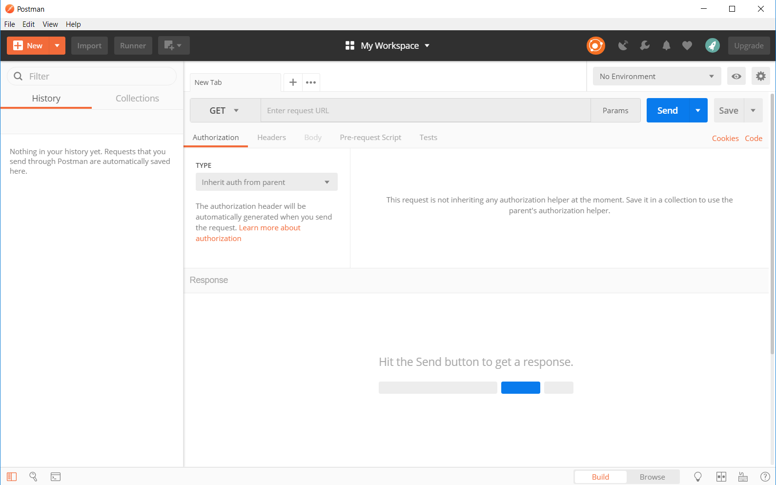
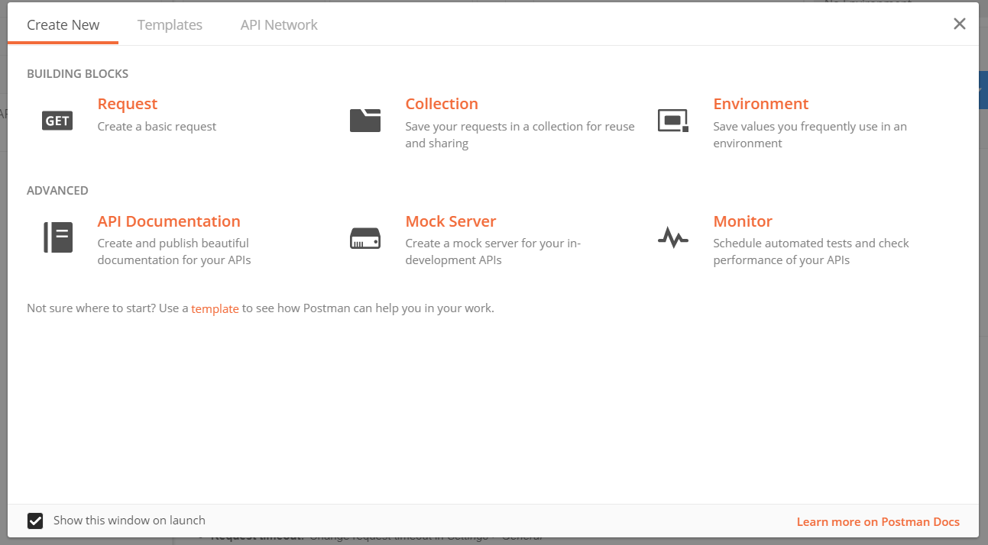
Create Our collection
Notes:
If you haven’t opened Postman before, or if you have and haven’t unchecked the box on the bottom left, you’ll see this when you launch Postman.
Go ahead and close this screen
*There is a feature to import an API based on the Swagger, which will help us get up and running faster.
Go ahead and click Import, then choose Import From Link, and paste in the link to the swagger

Slide 31
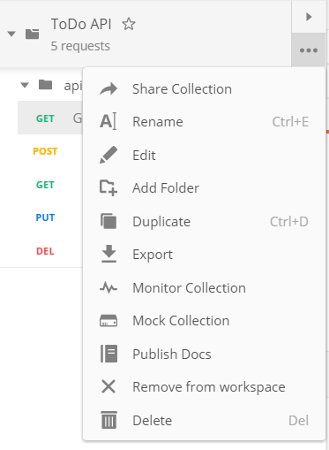
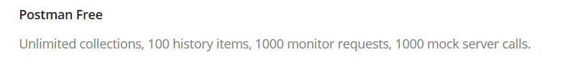
Getting Around in Postman
Collection contains requests
Share it in your own documentation/git repo
Export as JSON for anyone to use
Monitoring
Mocking
Notes:
Now that we have our requests in a collection, we can do some things with that collection
Even with a free Postman account, we can use the monitoring and mocking functions which is pretty cool
<<explain each one>>
There are a ton of features that we’re not going to talk about, for the interest of time. I encourage you to look at the documentation and try stuff out

Slide 32
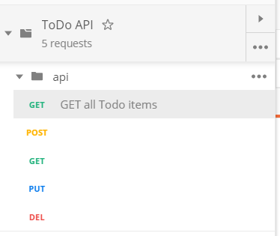
Getting Around in Postman
Check out each request
Verbs
URL
Headers
Params
Request Body
Rename each request to match what it really does
Notes:
Let’s check out the requests themselves
Look at Verbs, URL, Headers (quickly explain what they mean), Params, Request Body (and how choosing the diff types in Request Body will change headers)
Auth of course – we’re not using any auth on this one but you can see it supports many options
Pre-request scripts
And you can write tests here in Javascript. Those tests can be put into your CI/CD pipeline with Newman if you like.
We won’t be using this feature because we want to have our automated tests live with our production code, and in the same language
Rename each request to match what it does – for example, I renamed the first one to GET all Todo items. The POST would be POST new Todo Item
<< give a min or two>>

Slide 33
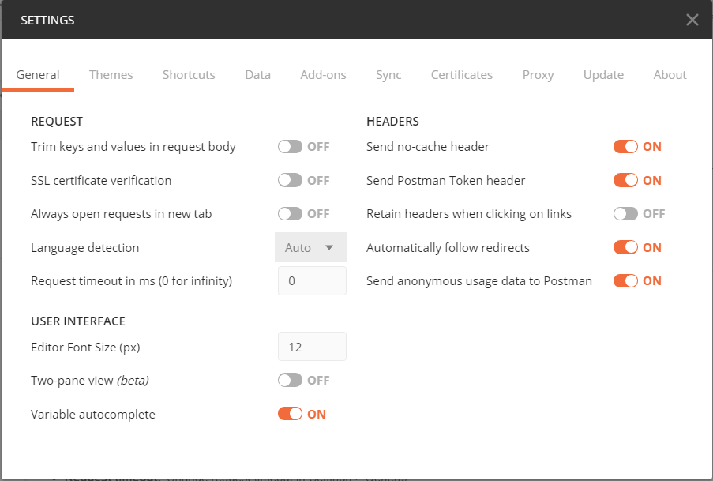
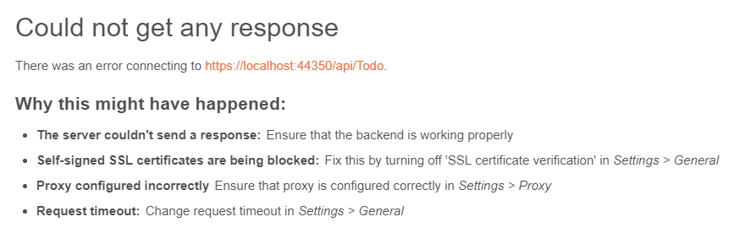
Getting Around in Postman
Try out a GET request
Notes:
Try out a request
* If you see this message, there’s a setting we need to fix
* Go to file -> settings, and turn SSL Cert Verification off

Slide 34
Getting Around in Postman
Try out a GET request
Response Body
Headers
Status Code
Time
Try a POST request
{ "name": "test", "isComplete": false }
Notes:
Look at the response body – these are all of our to-do items right now
The headers of the response
Cookies if there were any
The status code is clear right here, and has an explanation if we need more info
It also shows the time – how long the request took round-trip
* Now let’s try a POST request. You’ll need to type some JSON into the Request Body which you can get from the swagger page
<<give a few minutes>>
We can see the new item’s ID from the response body, but we can also view it from the response headers with the location attribute

Slide 35
CRUD Tests

Slide 36
Testing crud operations
Create, Read, Update, Delete
Test separately to validate each method works
Test the lifecycle of an object
Catch issues with caching or concurrency
Create -> Read -> Update -> Read -> Delete -> Read

Slide 37
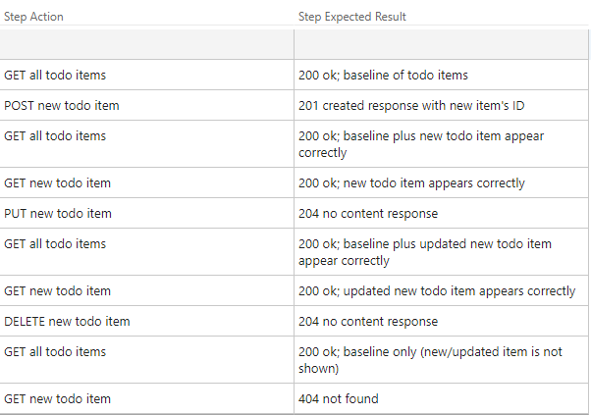
Testing crud operations
Notes:
This is what our test case would look like
Let’s all go ahead and run these tests. Remember we’re just testing CRUD operations here, not anything with the fields individually yet. That’s coming
Note anything that doesn’t seem correct

Slide 38
Boundary Testing

Slide 39
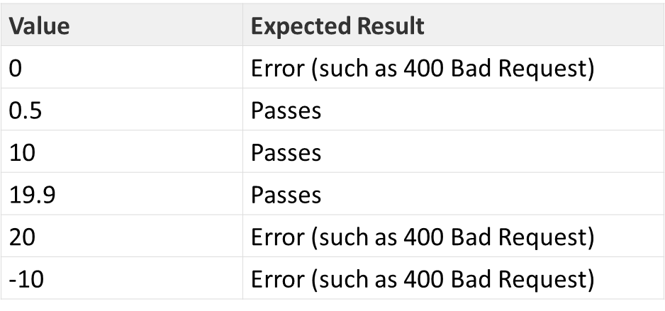
Testing boundaries
Above and below numerical limits
Value must be <= 19.9 and Value must be > 0

Slide 40
Testing boundaries
Item Name
1-255 Characters
Due Date
Month
Day
Year
https://goo.gl/sQ9Zej
Notes:
For the item name, we can just use as many or as few characters as we want
You’ll want to go to a random string generator, if you haven’t already visited one. Here’s one you can put in the number of characters and it’ll spit it out for you
For the date, we can try dates in the past, or the future, or dates that make no sense
We don’t want people to be able to add To Do items that were due in the past

Slide 41
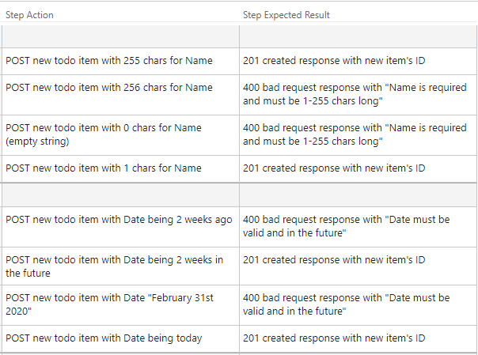
Testing boundaries
Notes:
So here’s what I’ve got for our tests based on our requirements – (read through each)
Go ahead and test some of these out and see if we find any bugs
Looking at all of these, are we missing anything?
Potential bugs: DateDue tests error response messages aren’t “nice”

Slide 42
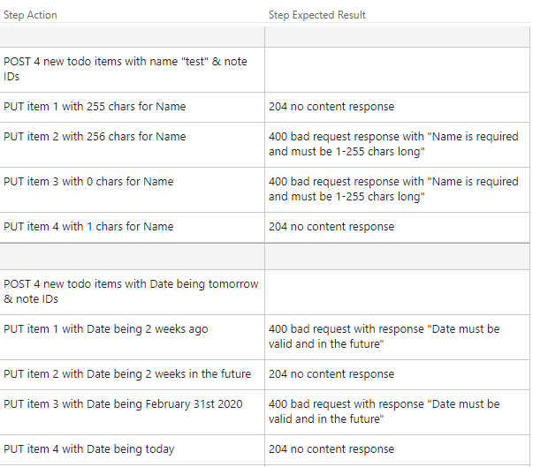
Testing boundaries
Notes:
We didn’t test the PUT operation at all there. We need to test both as the code may not be the same for both
Potential bugs: no character count validation on PUT operations, no date validation on PUT operations
have you tried doing a GET of the item you’re updating? We need to make sure we’re updating the items properly! The POST response shows the data we have for the item, but the PUT does not so we need to verify it

Slide 43
Required fields

Slide 44
Testing required fields
If required data is omitted, it yields an accurate response
If I fail to submit required information
Will I be able to understand how to fix it?
Is it handled gracefully?
Is the request processed as if it wasn’t required?
Notes:
So Name is our only required field, and we’ve kind of tested it with our boundary tests but not quite!

Slide 45
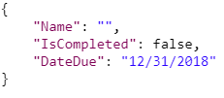
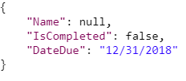
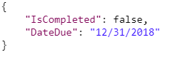
Testing required fields
Notes:
There’s a big difference between an
* Empty string
* Null value
* And missing value
These may or may not be identified individually in the code, but they can certainly be sent that way by our users, so we need to test that

Slide 46
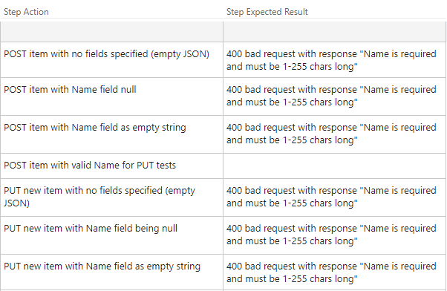
Testing required fields
Notes:
Test these out and see if we have any more bugs
Potential bugs: PUT requests have no validation

Slide 47
Field Types

Slide 48
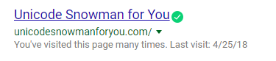
Testing field types
If the client sends a different data type than what is expected
Expect INTEGER, send
STRING
DECIMAL
☃

Slide 49
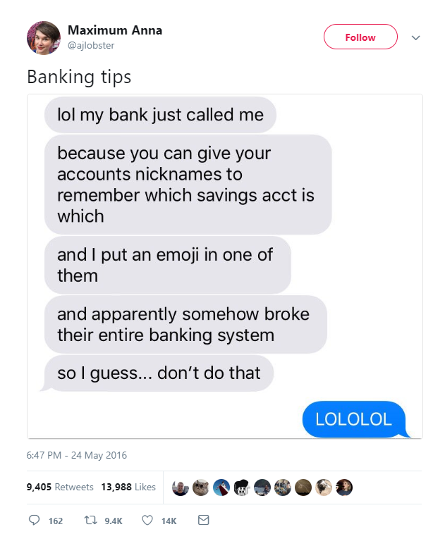
Testing field types
Notes:
Emoji are Unicode! It’s a great tool for testing things out

Slide 50
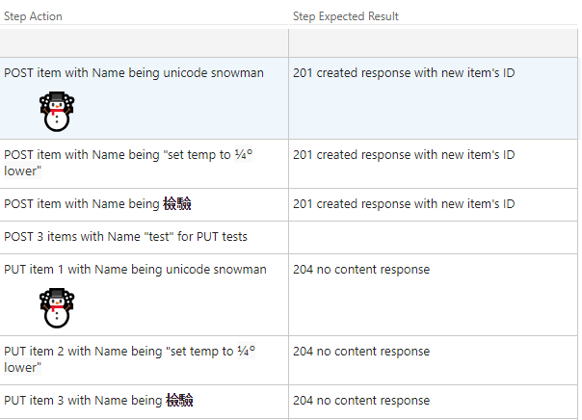
Testing field types
Notes:
So we can test the Name field – it allows a string and we want to be sure it’s allowing all kinds of characters.
Because it’s a string it can really take in dates, integers, bools, anything so we’re not too concerned about that one other than encoding.
We can copy Unicode snowman from that website, and to type the ¼ it’s hold down ALT and type 0188 on the keypad, degree symbol we hold down ALT and type 248 on the numpad
We can google “translate english to Japanese or Chinese” and put in some text like “testing”
potential bug with if you do a PUT of an item with an empty string, and then try a put again with a legit name, you’ll get a 400 bad request with “name is required”

Slide 51
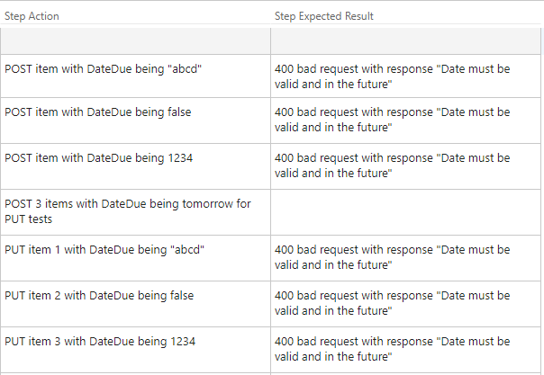
Testing field types
Notes:
The other field we can test is the DateDue field. The Datatype is DateTime so we need to try to see what’s handled and what’s not.
They’re all failing with 400 bad request, but our messaging isn’t great. That means we’re not really handling it gracefully and letting ASP.NET handle it for us. It’s ok, but we should really have better handling around this
Potential bugs: error message on failure can be improved

Slide 52
Failure

Slide 53
Testing for failure
Testing for (mostly) uncontrollable circumstances
404 Not Found Errors
500 Internal Server Error
Timeouts
Server Down
Database not responding
Notes:
We call this “Failing Gracefully”.
It’s very easy to test for 404 Not Found errors which we’ll do in a minute, but the other types of tests require some assistance from others, service virtualization, or something like Chaos Monkey like they do at Netflix

Slide 54
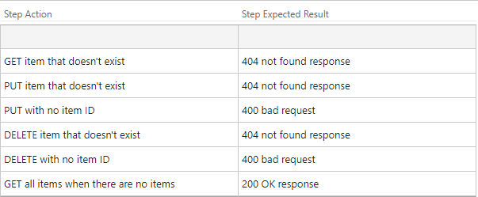
Testing for failure
Notes:
Generally we want to test for those things that “a user would never do” to make sure we can handle it. If our API crashes and burns because something fatfingered the ID of the item they want to delete, we’ve got a problem!
Remember if we get a 500 response back, that’s basically our API saying “Oops we messed up and we didn’t handle this scenario”
Potential bugs: PUT with no item ID = 404 not found, should be a 400 bad request, DELETE with no item ID same issue; GET all when no items requires commenting out code, restarting service

Slide 55
Testing for failure
How does the UI react when our API has these issues?
What happens if that 3rd Party API has these issues?
Use Service Virtualization!
Notes:
When we’re testing for failure, we should think about failure scenarios in these ways.
* We can use service virtualization to test out what would happen in these scenarios, especially with 3rd party apis, and our UI
Service virtualization is kind of it’s own workshop, so I encourage you to check that out

Slide 56
security

Slide 57
Testing security
Authentication vs. Authorization
Authentication (who they are)
Authorization (what they can do)
Does the request have a valid token?
Does the token allow access to this resource?

Slide 58

Testing security
Encryption
Use Fiddler or Wireshark to see what the requests look like “over the wire”
SQL Injection
Cross-Site Scripting
Fuzzing
Sending tons of malformed data and see where it breaks
Notes:
We don’t have authentication testing to do on our API as it’s anonymous so anyone can use it. But we can do some of the other tests

Slide 59
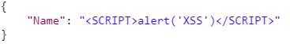
Testing security
Notes:
Let’s do a quick test – create a new todo item using this request body. Then refresh the webpage with our list of todo items

Slide 60
exploratory

Slide 61
Exploratory testing
“Exploratory Testing” is a style of testing in which we learn about the behavior of a system by designing a small test, executing it immediately, using the information gleaned from the last test to inform the next.
-Elisabeth Hendrickon
Not scripted
Not pre-planned
Let the application lead you
Use your past experience as heuristics

Slide 62
Exploratory testing web services
Apply the same principles as with a GUI interface
Think about other uses
What else uses the API now?
What else could use the API in the future?

Slide 63
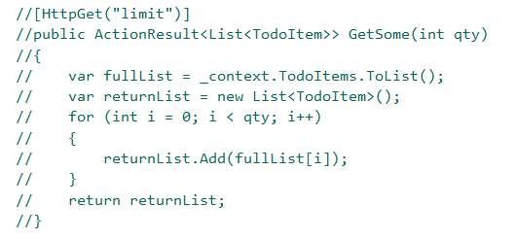
Exploratory testing web services
https://localhost:[port]/api/Todo/limit?qty=2
Notes:
Go ahead and uncomment this method in the TodoController, and run it again
Add a few items, then test out this new feature. Use what you know already, or look at the method and get some ideas. I promise you there are bugs here!
You can also go back to any of the other areas we touched earlier and test some things out.

Slide 64
Automated checking
Notes:
Ok so we’re moving on from using Postman, and we’ll be digging into coding
Note that all of the code we’re going to be writing is in the TodoApi repository already – just on different branches so if you get behind or need to step out, the code is all there

Slide 65
Automated checking of web services
Automate what can be checked repeatedly
Binary decisions (true or false)
Does response code match what I’m expecting for this request?
Is the response time within the SLA?
Do not automate
Every single test case
Low Reward/High Effort
Cases that require manual intervention
Notes:
Effort isn’t just about up-front writing the initial code, it’s maintenance down the line too – 1 month, 3 months, 6 months, 1 year – what will this code need to do then?

Slide 66
Automation process
Decide on tooling
Notes:
For tooling, I tend to use what is already being used for the application under test. For most applications, I put the tests in the same solution as the production code. This helps to make the tests first class citizens in the code, we can enforce the same coding standards, and it’s all in one place. Obviously that doesn’t always make sense, but it should be considered.
I also use the unit testing framework that the devs are already using.
For our solution, we’re using C# of course, and NUnit is the team’s chosen unit testing framework, so that’s what we’ll use.

Slide 67
Automation process
Decide on tooling
Common Utility Methods
Performing the Web request
Reading response content
Generating data
Notes:
We’ll definitely need some utility methods first that will help with all of our tests
NOTE: there are tools to do this stuff for you, like RestSharp. We’re not using RestSharp here so you can fully see how this whole process works.
So when you get back to work, or for you personal projects, look into RestSharp! I have implemented all of the following tests using RestSharp in another branch of the repo, so you can reference that later.

Slide 68
Automation process
Decide on tooling
Common Utility Methods
Performing the Web request
Reading response content
Generating data
Models
Classes for the requests and responses
Easier to manipulate an object for testing than a string
Notes:
We need to make sure all of the models we need exist, and if they don’t we need to create them
Now we don’t need to actually create models as the model we need to use is right there in the solution.

Slide 69
Automation process
Before we continue…
Serialization & Deserialization!
Notes:
The reason we need these models is to better manage our objects. And to use our objects, we need to understand serialization and deserialization

Slide 70
Automation process
Deserialization
TodoItem
Id: 10
Name: mow lawn
DateDue: 6/26/18
IsCompleted: false
TodoItem
Id: 10
Name: mow lawn
DateDue: 6/26/18
IsCompleted: false
{
“Id”: 10,
“Name”: “mow lawn”,
“DateDue”: “2018-26-06T00:00:00”,
“IsCompleted”: false
}
Serialization
Notes:
Let’s say we have this TodoItem object. A client does a Get of this item, so we need to send it somehow.
We Serialize it, to change it from an object into something we can send that other systems understand. In this case, we change it into JSON.
If someone wants to use our API but doesn’t want to use C#, for instance, they can still do that since we serialize our responses into non-proprietary JSON strings.
***
Now lets say in our test, we need to do a GET of the item, but we also want to verify a certain field, like the Name. We could just take that JSON string we get back from the web request and parse it out every time. But that sucks – especially if a new field is added, that could break everything!
If we Deserialize it back into an object we know the properties of, it’s so much easier to manipulate, verify certain fields, etc without having to parse strings.

Slide 71
Automation process
Decide on tooling
Common Utility Methods
Performing the Web request
Reading response content
Generating data
Models
Classes for the requests and responses
Easier to manipulate an object for testing than a string
Prioritize automation tasks
Write automation!
Notes:
We need to prioritize what should be automated first, and what should be automated at all. That’s another whole talk in itself, but it helps to think about risk – is what you want to automate going to change any time soon? If it does change, what happens if it doesn’t work? I’ve added some resources at the end to help you with that
And then we start writing our automation!

Slide 72
Automation process
Create a class for tests
Set up the Test Fixture
Create Initialize method
Notes:
First we need to create a new class for our tests, set up the Test Fixture, and then we create an initialize method for variables we’ll use across our tests
(Exercise 1)

Slide 73
Automation process
Start with Smoke Tests
Verify your utility methods work
Quickly verify all endpoints
Add value fast
First Test
Verify a simple GET request returns a 200 OK response
Notes:
For our first tests, we should start small and simple. We’re not really testing full functionality or business logic here, just that the pipes are connected properly.
These tests are great to see ensure the environment is up after a code push, or maintenance. It doesn’t say everything is working, but it says things are working enough to continue testing, or hey we didn’t break everything!
(Exercise 2)

Slide 74
Automation process
Some more small, simple tests
Hit the service, validate we get a specific field back correctly
Hit the service, validate we get a certain number of items
Notes:
For our next test, we’ll continue on this small simple test track and verify when we do a get of a single todo item, we get the name back correctly.
We can also do a GET of all todo items, and count them – making sure we get 3 back
(Exercise 3)

Slide 75
Automation process
How do we know
our tests are working?
we’re testing the right thing?
Test your tests!
Notes:
Take a few minutes and test out your tests – we need to make sure they’re working properly. Intentionally make them fail!
For instance, check for a different name on that todo item.
<<if had time to do the List of items test in last exercise, this one will fail depending on execution order!>>
You should always test your tests! There’s nothing worse than a bad test that passes when it really should fail

Slide 76
Automation process
Make it more interesting (and complicated)
POST to the service, validate it posted
Subsequent GET to the service
Or read from the database
CRUD operations, in order
Notes:
(Exercise 4)
There are a lot more tests we can do, but we’ll do a simple POST then a GET to verify what we’ve sent was actually received.

Slide 77
Automation process
Data-driven tests
Same test structure, just different data and expected results
Required fields (especially if there are a lot)
Boundary tests
0 characters – 400 BAD REQUEST
10 characters – 201 CREATED
255 characters – 201 CREATED
256 characters – 400 BAD REQUEST
https://goo.gl/sQ9Zej
Notes:
(Exercise 5)
We’re going to be using this awesome feature of Nunit where you can do data-driven testing really easily
Again that random string generator is here – you’ll need this

Slide 78
Automate all the things!
Combine Integration and GUI Automation!
Example for TodoItem
POST via API
Get the TodoItem Id from the response body
Launch the web app with Selenium
Assert that TodoItem Id, with the same Name and details, appears properly
UI and API are talking to each other
Make UI automation faster

Slide 79
Test those web services!

Slide 80
Test those web services
No pretty UI for end users
Bugs in Web services cause just as many headaches for users
Different skill set for testers
A lot of the same principles
Seems complicated
Just a different window into our applications
Web Services Need Testing Love, Too!
Notes:
Give them some love!

Slide 81
That’s it!
Code, Postman Collection, and Resources
https://github.com/g33klady/TodoApiSample
Questions?

